Slide 1

DriveSure
Vehicle Insurance Management Platform
Risk-Based Digital Insurance System
Your car deserves protection — not just fuel. Our insurance shields you against accidents, theft & disasters. Third-party cover is mandatory under the Motor Vehicles Act, 1988. Policies from Rs. 2094/year with cashless repairs, hassle-free claims & 24x7 support.
3
4
360°
User Roles
Core Modules
Policy Coverage
Confidential — Leadership Presentation

Slide 2





Business Problem Statement
Traditional vehicle insurance operations face critical inefficiencies that slow service delivery and frustrate customers:
In today’s fast-paced world, car insurance is no longer a luxury — it is a legal and financial necessity. Yet traditional insurers continue to rely on paper-based processes, manual assessments, and siloed systems that leave customers frustrated and under-served. The result: delayed claims, opaque pricing, and a broken experience at every touchpoint. DriveSure was built to fix exactly that.
Manual Policy Processing
Complex Premium Calculations
Paper-based workflows lead to delays, errors, and high operational costs across policy issuance and renewals.
Manual risk assessments are inconsistent, prone to bias, and difficult to audit or standardize.
Slow Claim Approvals
Fragmented Departmental Systems
Claim reviews take days or weeks due to manual routing, document chasing, and lack of real-time status tracking.
Disconnected tools across sales, claims, and admin result in data silos and poor coordination.
Lack of Customer Transparency
Customers have no visibility into policy status, claim progress, or premium calculation logic.
DriveSure | Vehicle Insurance Management Platform

Slide 3
Proposed Solution
DriveSure — End-to-End Digital Insurance Platform
01 Digital Policy Management
Customers can apply for vehicle insurance online with document upload and instant tracking.
05 Online Claim Management
Customers submit claims with supporting documents; claim officers review and approve them efficiently.
02 Risk-Based Premium Calculation
Premium is calculated automatically using vehicle age, vehicle type, coverage amount, and risk score.
06 Real-Time Tracking and Transparency
Customers can track policy status, payment status, and claim progress directly from their dashboard.
03 Role-Based Workflow System
Separates responsibilities between Admin, Underwriter, Claim Officer, and Customer for better process control.
07 Admin System Management
Admin manages the platform — creating policies, managing users (underwriters and claim officers), and monitoring revenue and commission reports.
04 Automated Policy Approval Process
Underwriters review applications digitally and approve or reject policies through the platform.
DriveSure | Vehicle Insurance Management Platform

Slide 4




System Overview
Admin
Policy & User Management
Policy & Claims
Customer
DriveSure
Underwriter
Insurance Platform
Policy Review
Claim Officer
Claim Processing
Frontend: Angular (Role-Based Dashboards) | Authentication & Authorization | Responsive UI | Real-Time Notifications
Claim Processing
DriveSure | Vehicle Insurance Management Platform

Slide 5
Key Use Cases
Six core workflows that power the DriveSure platform
01 Customer Applies
02 Underwriter Reviews
03 Customer Pays Premium
Flow: Customer → vehicle details → upload docs → submit → risk score → underwriter review
Flow: Underwriter → view applications → evaluate risk score → approve or reject
Flow: Customer → view approved policy → pay premium → transaction stored → commissions calculated
A customer applies for a vehicle insurance policy by entering vehicle details and uploading required documents. The system automatically calculates a risk score and sends the application to the underwriter for approval.
The underwriter reviews submitted policy applications and evaluates the calculated risk score. Based on the assessment, the underwriter can approve or reject the application.
Once the policy is approved, the customer proceeds to pay the insurance premium. The system records the transaction and automatically calculates commissions for the underwriter and claim officer.
04 Customer Submits Claim
05 Claim Officer Processes
06 Admin Manages System
Flow: Customer → submit claim → enter details → upload evidence → claim stored → officer notified
Flow: Claim Officer → review claim → check documents → approve or reject
Flow: Admin → create policies → manage users → monitor revenue → commission analytics
If an accident occurs, the customer can submit a claim by providing incident details and uploading supporting documents. The system also supports third-party insurance claims, which are mandatory for vehicle owners under the Motor Vehicles Act, India.
The claim officer verifies the submitted claim details and supporting documents, then decides whether to approve or reject the claim based on eligibility and evidence.
The admin manages the entire system by creating insurance policies, managing users such as underwriters and claim officers, and monitoring system revenue and commission reports.
DriveSure | Vehicle Insurance Management Platform

Slide 6
Use Case Deep Dive: Customer Claim Submission Flow
1
Customer
2
Customer
3
Customer
4
Customer
Customer Login
Select Policy
Open Claim Form
Upload Documents
Authenticate via secure login portal
Choose from active insurance policies
Select claim type: self, third-party – vehicle damage/ Injury
Attach damage photos, and other reports
5
System
6
Claim Officer
7
Claim Officer
8
System
Submit Claim
Officer Review
Approve / Reject
Notification Sent
Claim request sent for review
Claim Officer validates and reviews claim
Decision made based on risk and evidence
Customer receives outcome notification
Customer
System / Auto
Claim Officer
DriveSure | Vehicle Insurance Management Platform

Slide 7


Risk & Premium Calculation Engine
Intelligent, transparent, and automated pricing logic
Risk Score Factors
Standard Premium Formula
Final Premium = Base Premium × Risk Score
Vehicle Age
Older vehicles carry higher risk scores
Coverage Amount
No Claim Bonus (NCB)
Higher coverage → higher risk coefficient
Risk Score Range: 1.0 (Low) → 5.0 (High)
Customers with no claims in the previous policy year receive a 10% discount on renewal.
Renewal Premium = (Base × Risk Score) × 0.9
Injury Claim Payout Structure
Vehicle Damage
Minor Injury
Serious Injury
Death
min(Garage estimated, Coverage Amount)
₹50,000 Fixed
₹1,50,000 Fixed
₹5,00,000 Fixed
DriveSure | Vehicle Insurance Management Platform

Slide 8
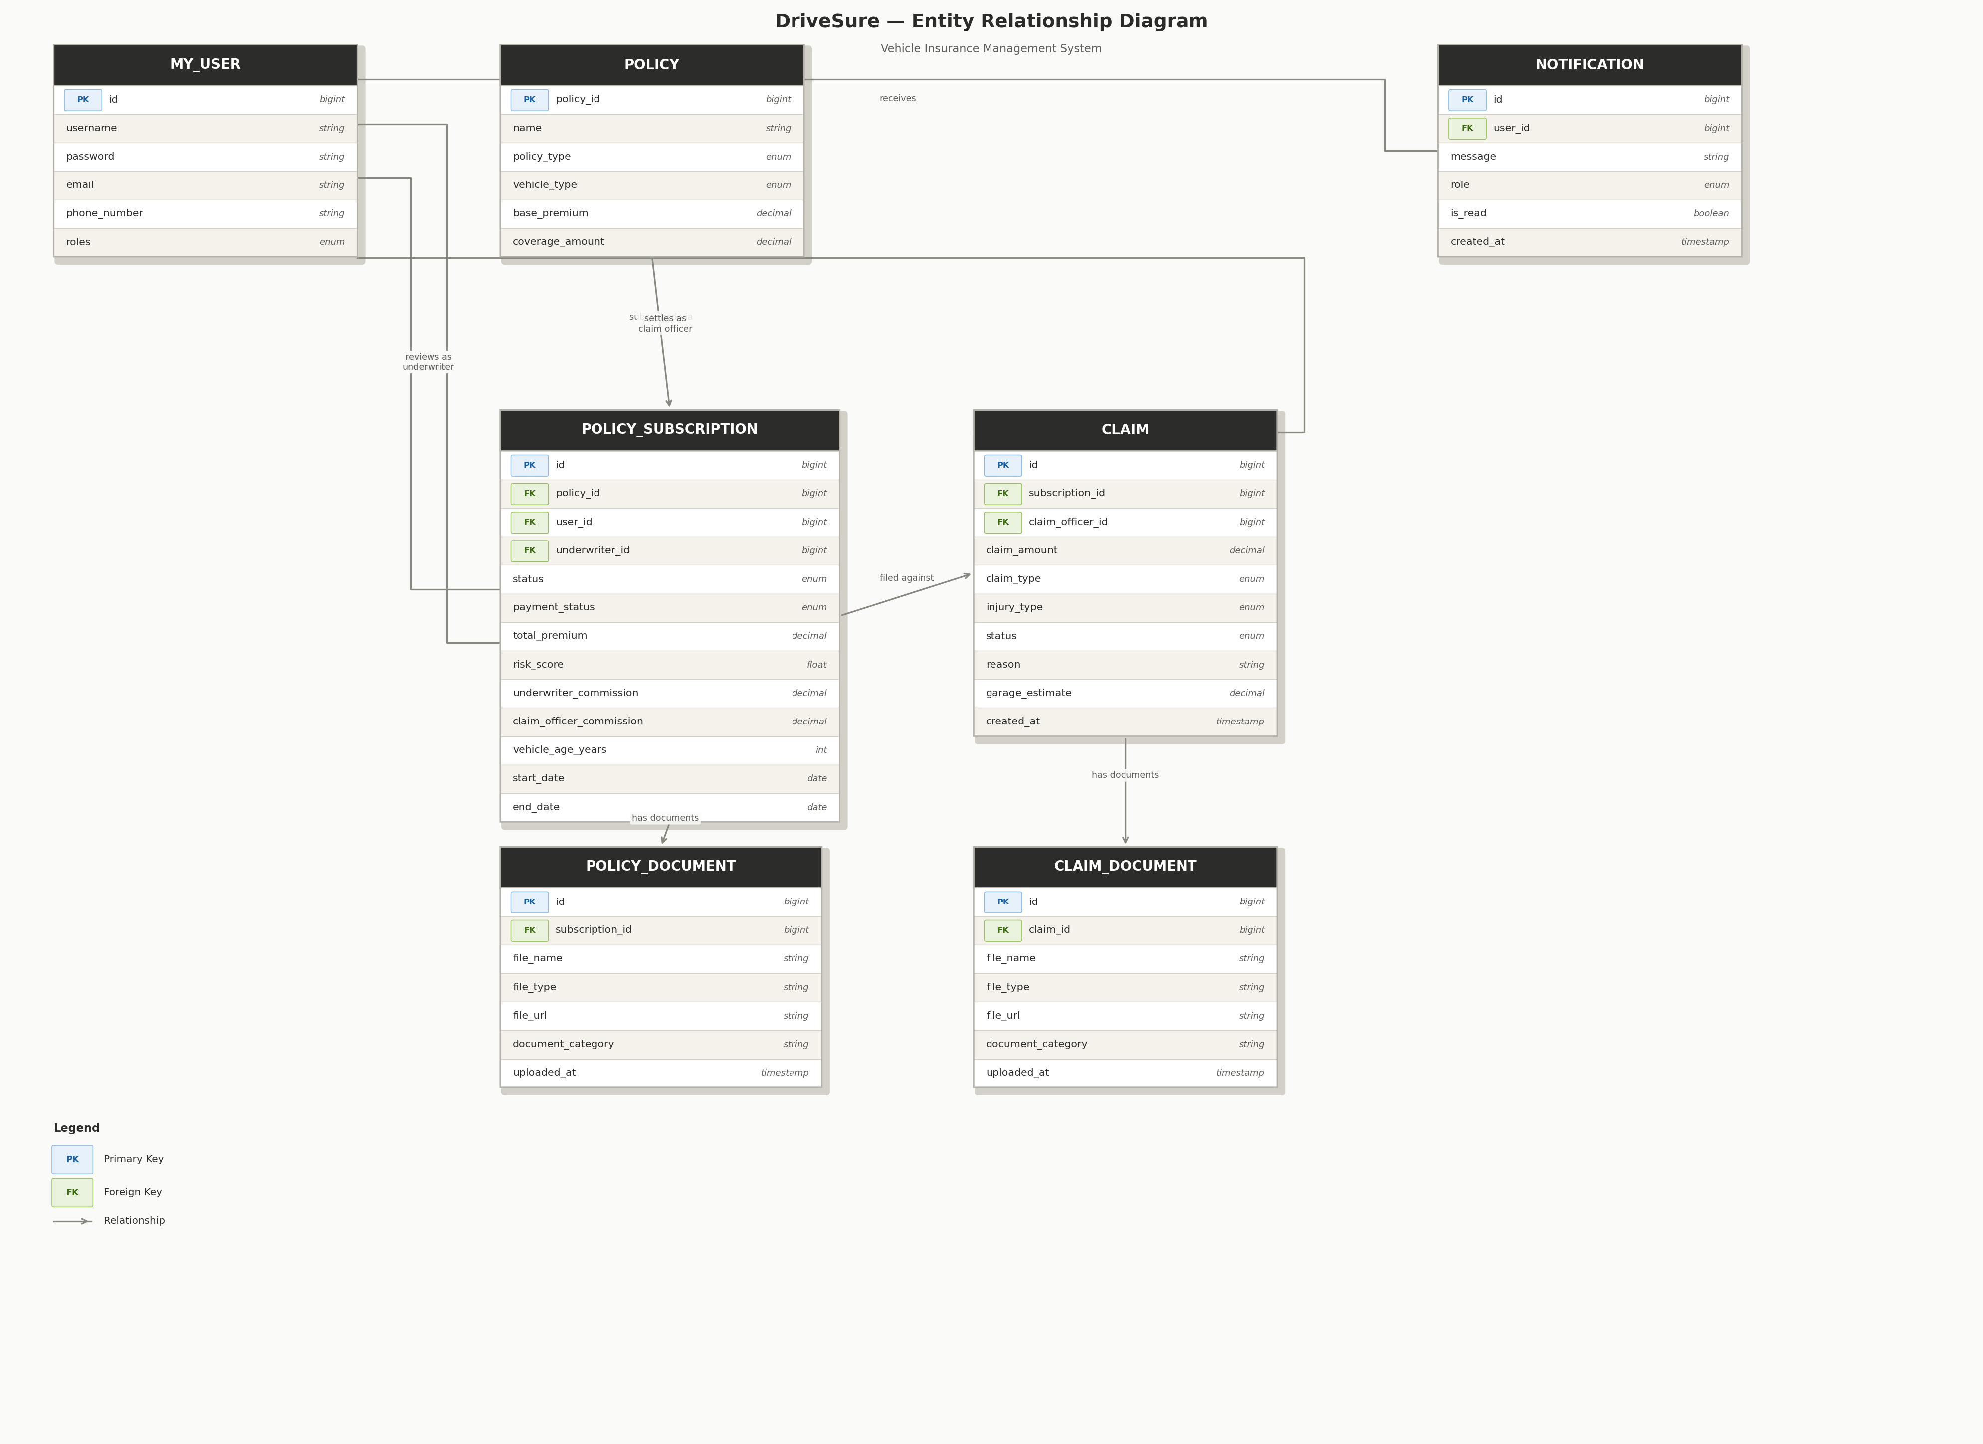

Slide 9





Business Impact & Benefits
↑ Speed
↓ Ops Cost
↑ Trust
Faster Processing
Reduced Manual Workload
Transparent Claims
End-to-end digital workflows reduce policy issuance and claim turnaround from days to hours.
Automated premium calculation, claim routing, and notifications free up staff for high-value tasks.
Customers track every step of their claim journey in real-time — building trust and reducing support calls.
↑ CSAT
↑ Accuracy
↑ Scale
Better Customer Experience
Data-Driven Pricing
Scalable Platform
Self-service portal enables policy purchase, renewal, and claims without requiring agent assistance.
Risk-based premium engine ensures fair, consistent, and auditable pricing for every customer.
Angular-based architecture supports growing user base, new policy types, and regional expansion.
DriveSure — Driving Insurance Into the Digital Future

